Slide 1
LIFT SALES & BUSINESS PERFORMANCE ANALYTICS
Power BI | Business Intelligence Project
Sales • Order Booking • Payments • Installation • Customer Analysis
Project Presentation | Pranit Pawar

Slide 2
Executive Summary
2
What this dashboard is designed to answer
SALES
How much business?
PAYMENTS
Received vs pending?
INSTALLATION
Completed vs in process?
CUSTOMERS
Who drives business?
Purpose: provide a single management view of the lift business lifecycle.
Business flow: Order Booking → Sales → Payment → Installation → Customer / Builder relationship.
The dashboard is designed to monitor performance by year, city, lift type, customer, builder and sales person.
Primary outcome: convert operational data into clear KPIs, trends and actionable business insights.

Slide 3
Business Problem & Objectives
3
Why the dashboard was created
Business Problem
• Sales, bookings, payments, installations and customer information need to be monitored together.
• Manual reports make it harder to identify declining sales, pending payments, installation backlog and top customers quickly.
Project Objectives
• Track total sales, lift volume, buildings and builders.
• Monitor year-wise sales and order-booking trends.
• Track received, partial and pending payments and discounts.
• Monitor installation progress and city-wise operations.
• Identify top customers, repeat business, top sales person and high-demand lift types.

Slide 4
Data & BI Workflow
4
From raw data to management insight
1. Data Source — Excel / structured lift-business records.
2. Data Cleaning — remove/handle duplicates, blanks and inconsistent values; standardize formats and data types.
3. Power Query — transform and prepare the dataset for reporting.
4. Data Modeling — organize business entities and relationships for analysis.
5. DAX — create KPIs and analytical calculations for sales, payment, lift and installation metrics.
6. Power BI — build interactive visuals, slicers, filters and management dashboards.
7. Insight — interpret trends and convert them into business recommendations.

Slide 5
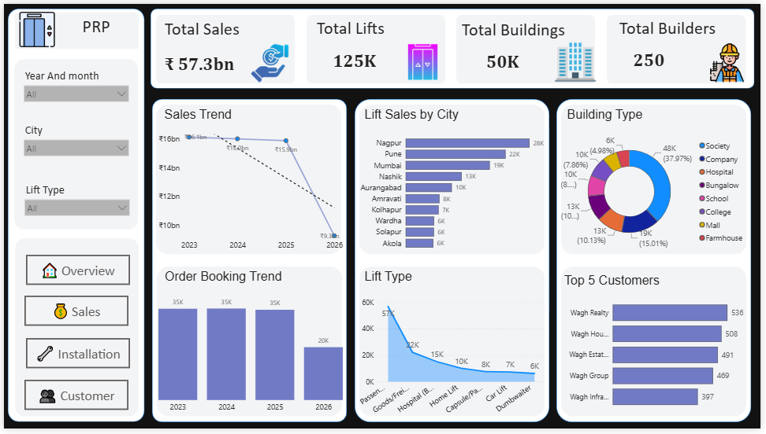
01 | Overview Dashboard
5
Executive-level business performance
Purpose:
Quickly understand overall sales, lift, building and builder performance, then drill into trends and segments.
Lift Sales & Business Performance Analytics | Power BI

Slide 6
Overview — Visual & Business Explanation
6
Why each visual is included
4 KPI Cards — Total Sales, Total Lifts, Total Buildings and Total Builders: instant snapshot of business scale.
Year-wise Sales Trend — Line Chart: monitor sales movement over time.
Insight: the dashboard indicates a slight year-wise decline in sales in recent years.
Order Booking Trend — Stacked Bar Chart: compare the number of lift orders/bookings by year.
Lift Sales by City — Bar Chart: identify high- and low-performing cities.
Lift Type — Line Chart: understand lift-type performance / usage trend.
Building Type — Donut Chart: understand the business mix across building types.
Top Customer — Bar Chart: identify customers contributing the highest business value.

Slide 7
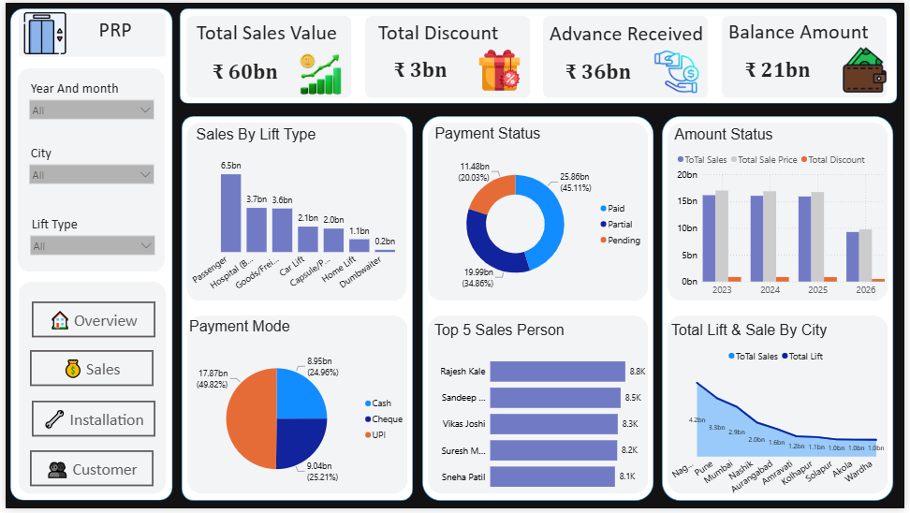
02 | Sales Analysis
7
Revenue, discount and collection performance
Purpose:
Understand sales value, discounts, advance collection, outstanding balance and sales performance by multiple dimensions.
Lift Sales & Business Performance Analytics | Power BI

Slide 8
Sales Analysis — Visual & Business Explanation
8
What management can track
KPI Cards — Total Sales, Total Discount, Advance Received and Balance Amount.
These KPIs answer: how much was sold, how much discount was given, how much was received and how much remains pending.
Sales by Lift Type — Bar Chart: identify the lift types generating more sales.
Payment Mode — Pie Chart: understand payment-method distribution.
Payment Status — Donut Chart: compare Paid, Partial and Pending payments.
Top Sales Person — Bar Chart: identify the best-performing sales person.
Amount Status — Customer Bar Chart: compare customer sales value, sales price and discount.
Total Lift & Sales by City — Line Chart: compare lift volume and sales across cities.

Slide 9
Payment Performance — Business Story
9
From sale value to cash collection
Total Sales represents the overall business value generated.
Advance Received shows how much amount has already been collected.
Balance Amount highlights the outstanding payment that may require follow-up.
Payment Status separates Paid, Partial and Pending cases for collection monitoring.
Payment Mode analysis helps understand how customers complete payments.
Business impact: regular monitoring can improve collection discipline and cash-flow visibility.

Slide 10
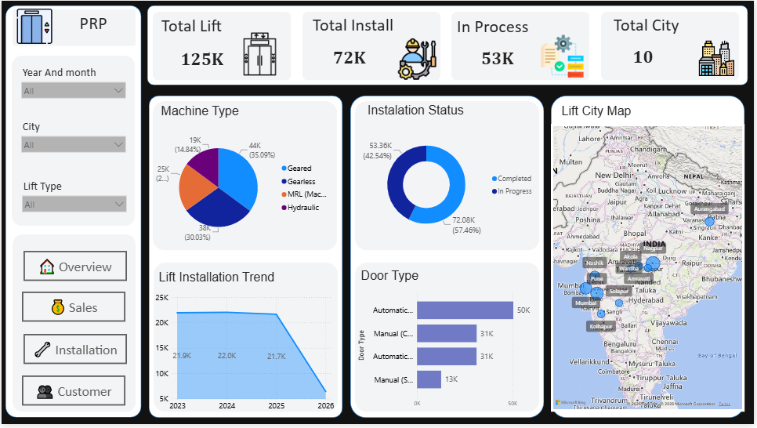
03 | Installation & Lift Status
10
Operational progress after the sale
Purpose:
Track how many lifts are installed, how much work is in process and where installations are concentrated.
Lift Sales & Business Performance Analytics | Power BI

Slide 11
Installation — Visual & Business Explanation
11
Operational monitoring
KPI Cards — Total Lift, Total Installation, In Process and Total City: monitor operational scale and workload.
Machine Type — Pie Chart: understand machine / lift configuration distribution.
Lift Installation Trend — Line Chart: monitor installation activity year-wise.
Installation Status — Donut Chart: compare Completed vs In Process work.
Door Type — Bar Chart: compare installation volume by door type.
City Map — geographic view of installation activity.
Business purpose: identify pending work and support installation planning and resource allocation.

Slide 12
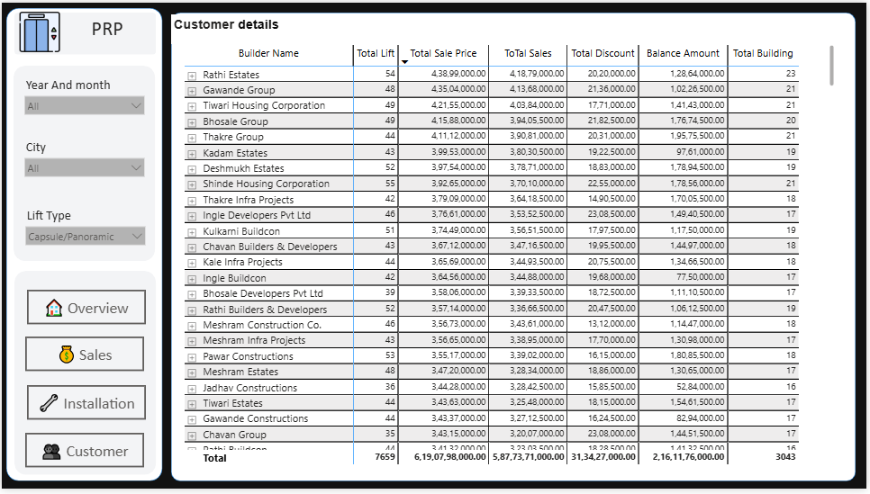
04 | Customer Details
12
Customer, builder and project-level performance
Purpose:
Track builder/customer contribution through lifts, sales price, discount, balance and building count.
Lift Sales & Business Performance Analytics | Power BI

Slide 13
Customer Analysis — Visual & Business Explanation
13
Identify valuable and repeat business
Builder Name — identify the business relationship / account.
Total Lift — measure the number of lifts associated with each builder/customer.
Total Sales Price — measure customer contribution to business.
Discount — monitor discount provided to customers.
Balance — identify outstanding amount by customer / builder.
Total Building — understand project scale and relationship depth.
Use this analysis to identify top customers, repeat customers and high-value builder relationships.

Slide 14
End-to-End Business Analysis
14
How the four dashboard pages connect
01 Overview → What is the overall business performance?
02 Sales → What was sold, at what value, with what discount, and how much payment is pending?
03 Installation → What has been installed and what is still in process?
04 Customer Details → Which customers/builders drive sales, lift volume and outstanding balances?
Cross-analysis → Compare performance by year, city, lift type, building type, customer and sales person.
Result → A complete management view from booking and sale to collection, installation and customer relationship.

Slide 15
Key Business Insights
15
What the dashboard reveals
Sales Trend — year-wise sales show a slight declining trend in recent years.
City Performance — sales and lift volume differ across cities, highlighting stronger and weaker markets.
Payment — Paid, Partial and Pending statuses provide visibility into collection performance.
Installation — Completed vs In Process status shows operational progress and pending workload.
Customer — top customer / builder analysis helps identify valuable and repeat business.
Product Mix — lift type, machine type, door type and building type show the business mix and demand patterns.
Sales Team — top sales-person analysis supports performance comparison.

Slide 16
Business Recommendations
16
Actions based on the analysis
Sales: investigate the year-wise decline and strengthen lead generation, conversion and retention.
City: focus sales campaigns on low-performing cities while protecting strong markets.
Payments: prioritize pending and partial balances through structured follow-up.
Installation: reduce in-process backlog with better scheduling and operational monitoring.
Customers: strengthen relationships with top and repeat customers/builders.
Product Mix: focus on high-demand lift types while evaluating profitability.
Sales Team: analyze top-performer practices and improve team performance.

Slide 17
Technical Implementation
17
Skills demonstrated in the project
Power BI — interactive dashboard development and business reporting.
Power Query — data cleaning, transformation and preparation.
DAX — KPI and analytical measures for sales, payment, lift and installation analysis.
Data Modeling — structured relationships for cross-filtering and analysis.
Data Visualization — KPI Cards, Line Charts, Bar Charts, Donut/Pie Charts, Maps and interactive filters.
Business Analysis — trend identification, payment monitoring, customer analysis and operational insights.

Slide 18
Resume-Ready Project Description
18
Professional version
• Developed an interactive Power BI dashboard to analyze lift sales, order bookings, payment performance, installation status and customer analytics.
• Created DAX-driven KPIs for total sales, discounts, advance received, outstanding balance, lift volume and installation progress.
• Built year-wise, city-wise, lift-type, customer, builder and sales-person analysis to identify business trends and performance gaps.
• Identified a slight declining sales trend and generated recommendations for sales improvement, payment collection, customer retention and installation efficiency.

Slide 19
GitHub Project Structure
19
Recommended professional repository
Repository: Lift-Sales-Business-Performance-PowerBI
README.md — project overview, problem, objectives, dashboard, insights and recommendations.
PowerBI/ — .pbix project file.
Dataset/ — source Excel dataset (if permitted to share).
Dashboard_Screenshots/ — Overview, Sales, Installation and Customer screenshots.
Documentation/ — Project Overview, Data Cleaning, Data Model, DAX Measures and Business Insights.
Presentation/ — project presentation PPT.
Important: remove confidential/company-sensitive data before publishing.

Slide 20
Project Conclusion
20
From operational data to business decisions
The dashboard provides an end-to-end view of the lift business lifecycle:
Booking → Sales → Payment → Installation → Customer / Builder
It helps management monitor KPIs, identify trends, track pending payments, follow installation progress and understand customer contribution.
The project demonstrates practical Power BI, Power Query, DAX, data modeling, visualization and business-analysis skills.
THANK YOU | QUESTIONS & DISCUSSION

